Slide 1


DATA COMMUNICATION
CSE 225/233
WEEK-4, LESSON-2
DIGITAL TRANSMISSION

Slide 2






Analog to Digital Conversion
As we have seen, line coding can be used to convert binary data to a digital signal. Sometimes however, our data is analog, such as audio. If we want to store the audio by recording it in a computer so that we can send it digitally, we need to change it through a process called sampling.
Topics discussed in this section:
Pulse Code Modulation (PCM) Delta Modulation (DM)
4.2

Slide 3
Pulse Code Modulation (PCM)
The most common technique to change an analog signal to digital data (digitization) is called pulse code modulation (PCM). A PCM encoder has three processes
The analog signal is sampled.
The sampled signal is quantized.
The quantized values are encoded as streams of bits.
Components of PCM encoder is discussed in the next slide.
4.3

Slide 4
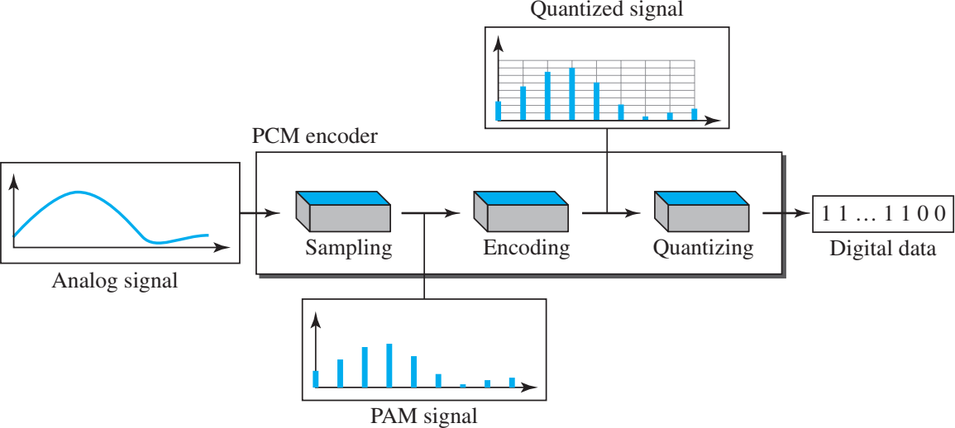
Components of PCM Encoder
4.4

Slide 5
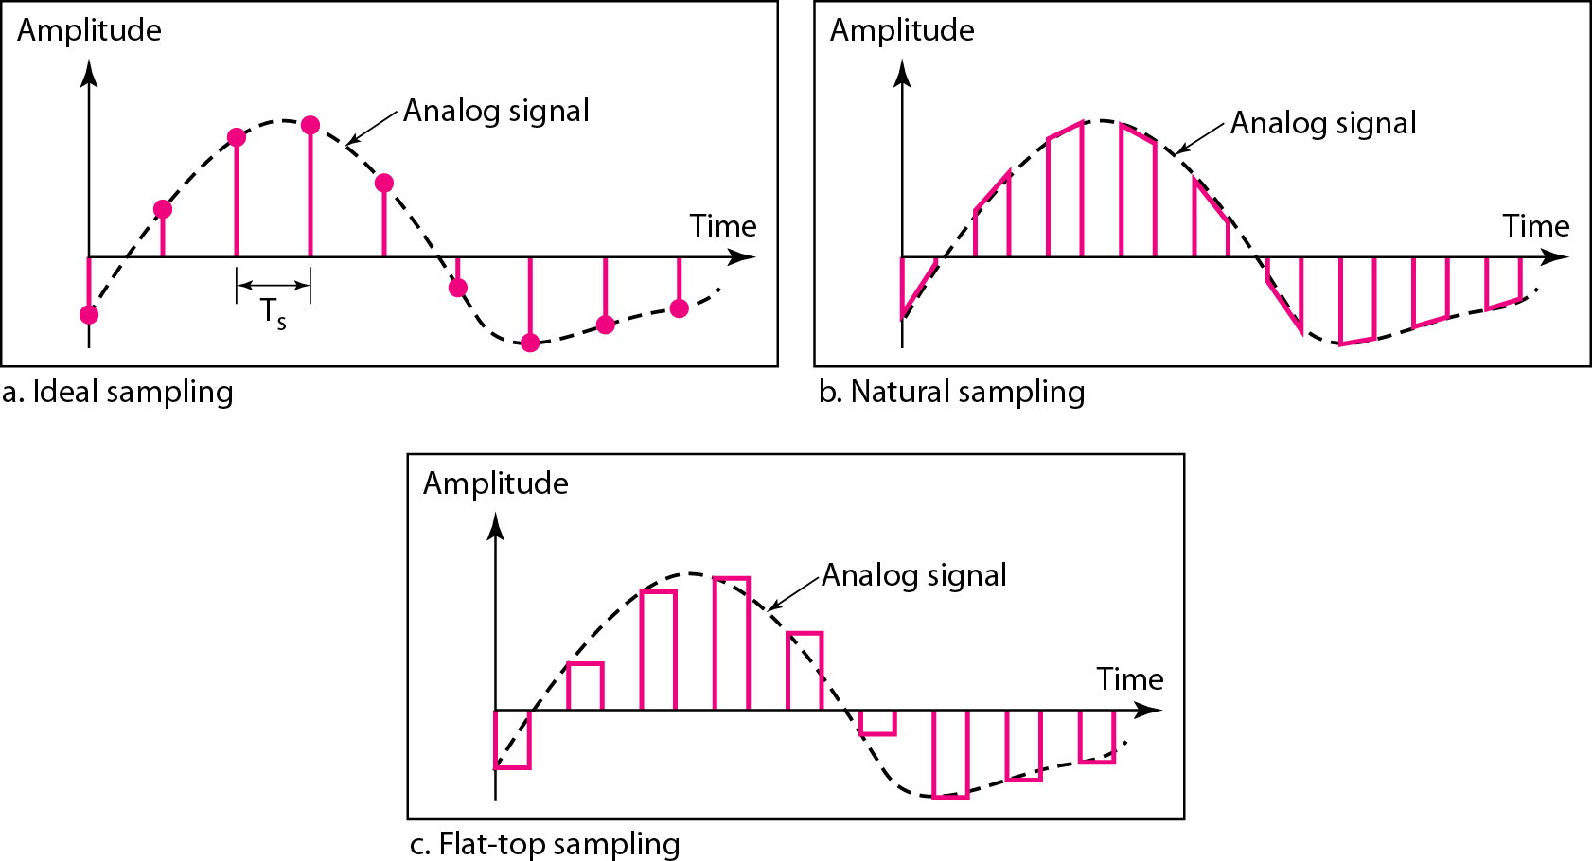
Sampling Techniques
4.5

Slide 6
Sampling Techniques
Ideal sampling: The analog signals are sampled and this method cannot easily implemented.
Natural Sampling: A high speed switch is turned on only the small period of time when the natural sampling occurs. The result is a sequence of samples that retains the shape of the analog signal.
Flat-top Sampling: The most common sampling method, called sample and hold, creates flat-top samples by using a circuit.
The sampling process is sometimes referred to as pulse amplitude modulation (PAM). However, the result is still an analog signal with non-integral values.
4.6

Slide 7
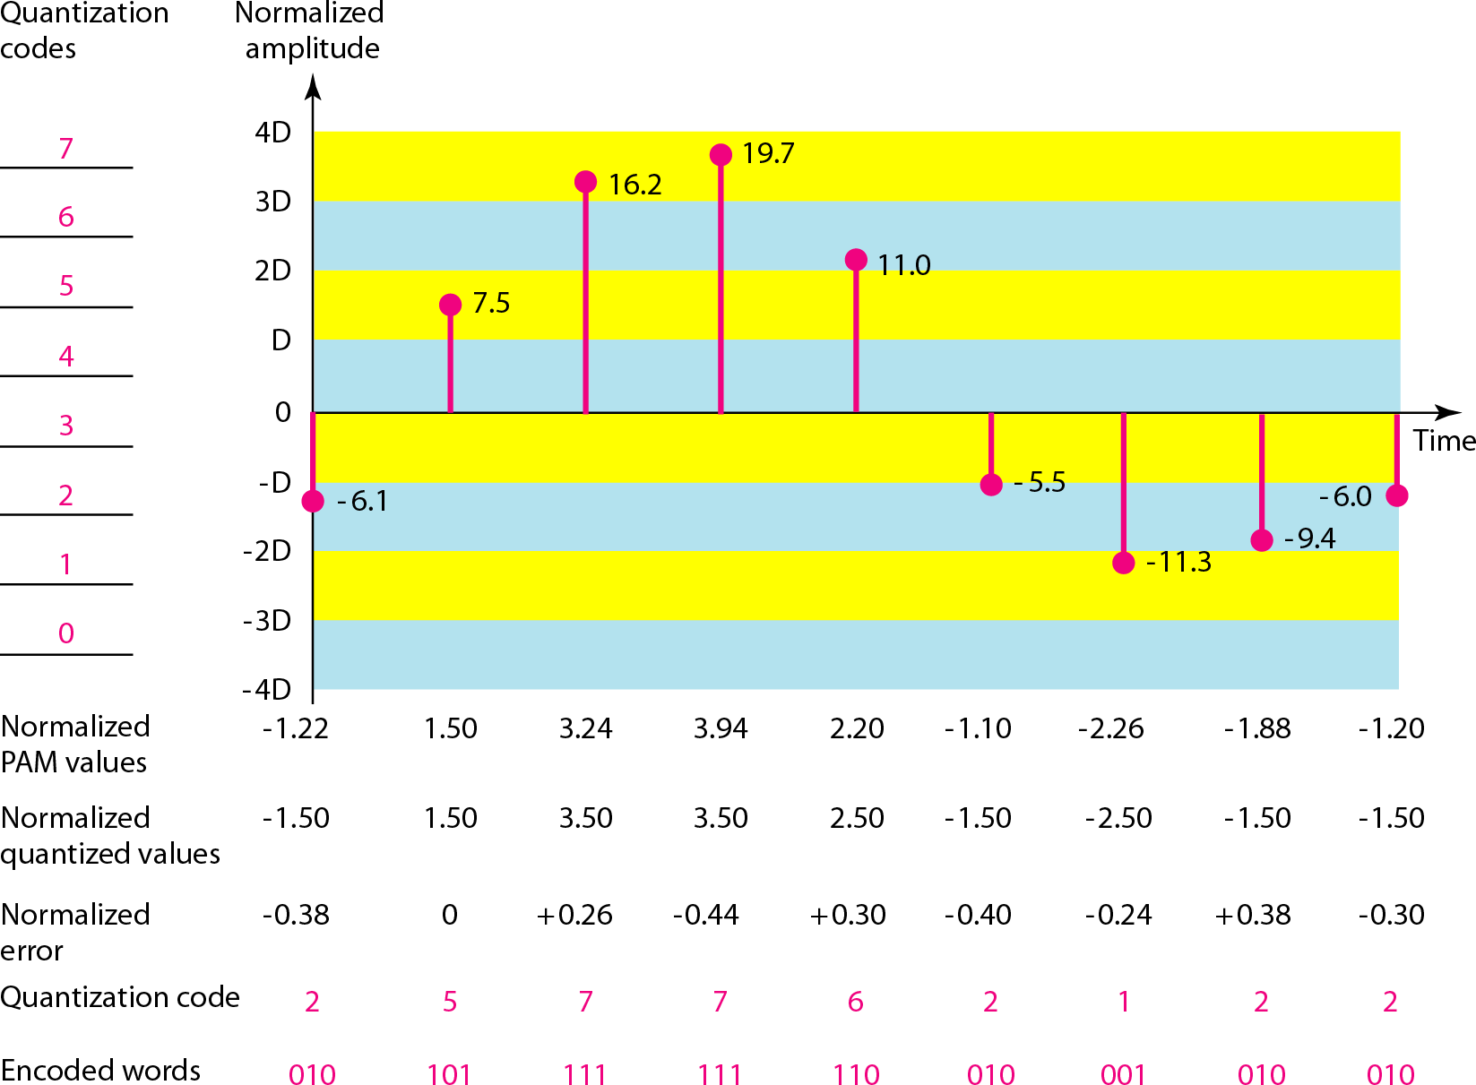
Quantization and encoding of a sampled signal
4.7

Slide 8
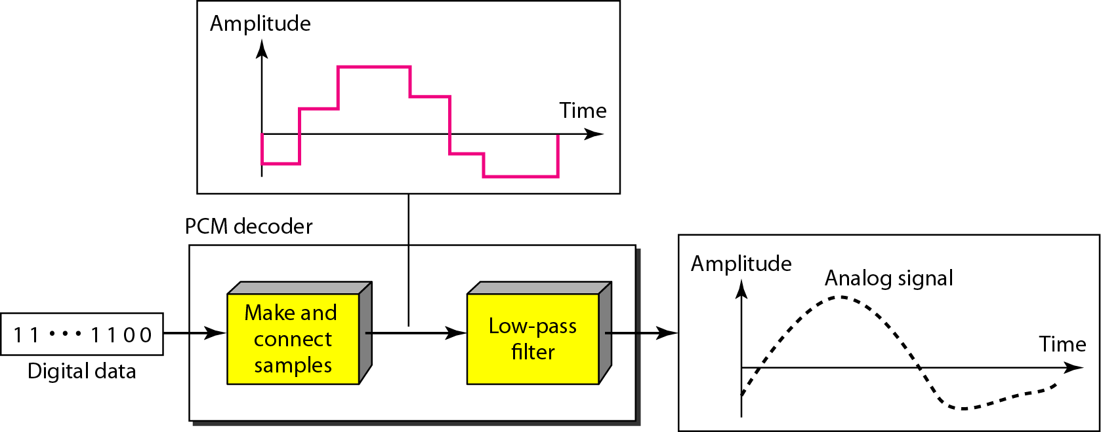
Components of PCM Decoder
4.8

Slide 9
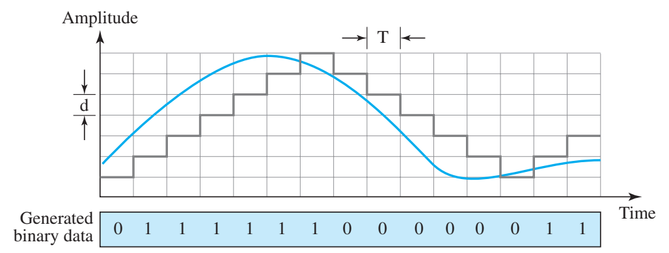
Delta Modulation (DM)
PCM is a very complex technique. Other techniques have been developed to reduce the complexity of PCM. The simplest is delta modulation (DM). PCM finds the value of the signal amplitude for each sample; DM finds the change from the previous sample. Following figure shows the process. Note that there are no code words here; bits are sent one after another.
4.9

Slide 10
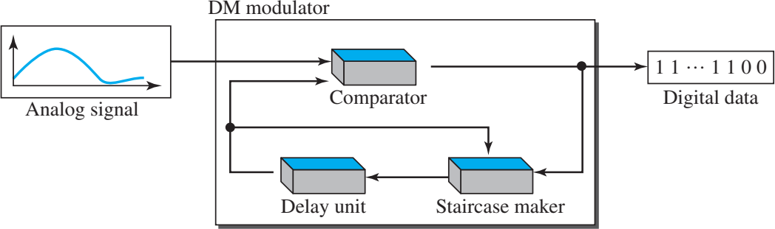
Components of Delta Modulator
4.10

Slide 11
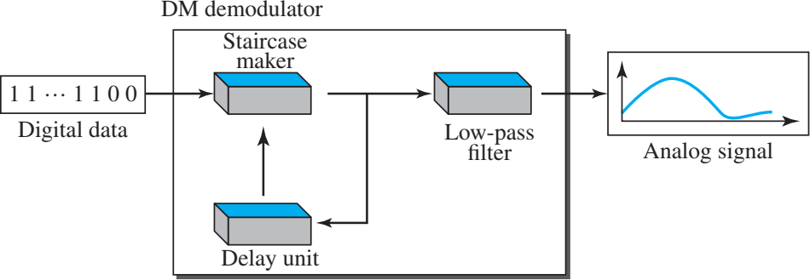
Components of Delta Demodulator

Slide 12
Transmission Modes
Of primary concern when we are considering the transmission of data from one device to another is the wiring, and of primary concern when we are considering the wiring is the data stream. Do we send 1 bit at a time; or do we group bits into larger groups and, if so, how? The transmission of binary data across a link can be accomplished in either parallel or serial mode.
In parallel mode, multiple bits are sent with each clock tick.
In serial mode, 1 bit is sent with each clock tick. While there is only one way to send parallel data, there are three subclasses of serial transmission: asynchronous, synchronous, and isochronous.

Slide 13
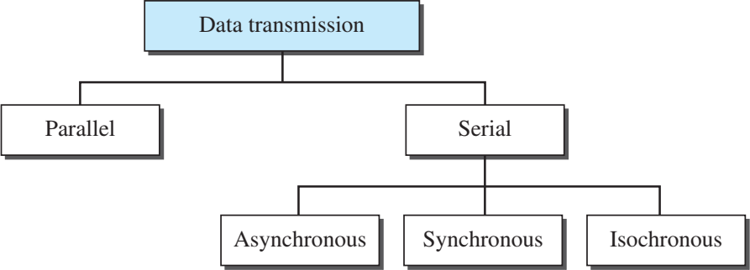
Data transmission modes

Slide 14
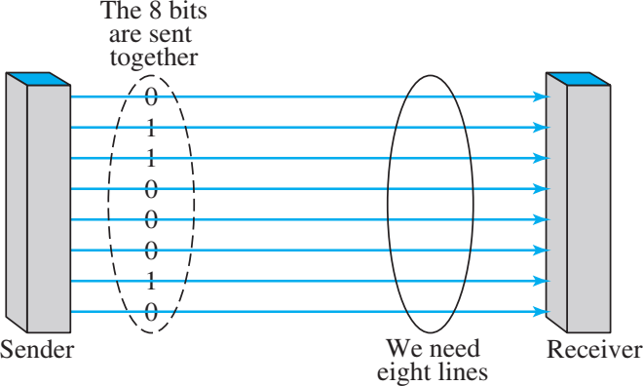
Parallel Transmission
Binary data, consisting of 1s and 0s, may be organized into groups of n bits each. Computers produce and consume data in groups of bits much as we conceive of and use spoken language in the form of words rather than letters. By grouping, we can send data n bits at a time instead of 1. This is called parallel transmission.

Slide 15
Parallel Transmission
Advantage: Parallel transmission can increase the transfer speed over serial transmission.
Disadvantage: It is expensive and usually limited to short distance.

Slide 16
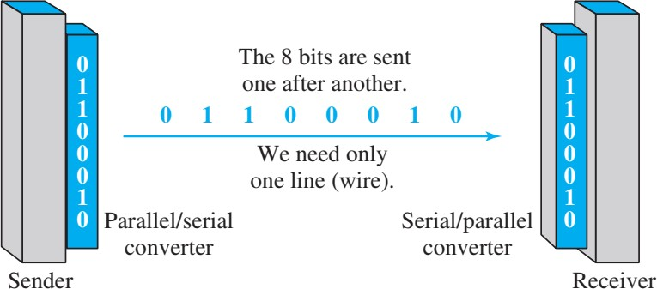
Serial Transmission
In serial transmission one bit follows another, so we need only one communication channel rather than n to transmit data between two communicating devices. The advantage of serial over parallel transmission is that with only one communication channel, serial transmission reduces the cost of transmission over parallel by roughly a factor of n.

Slide 17
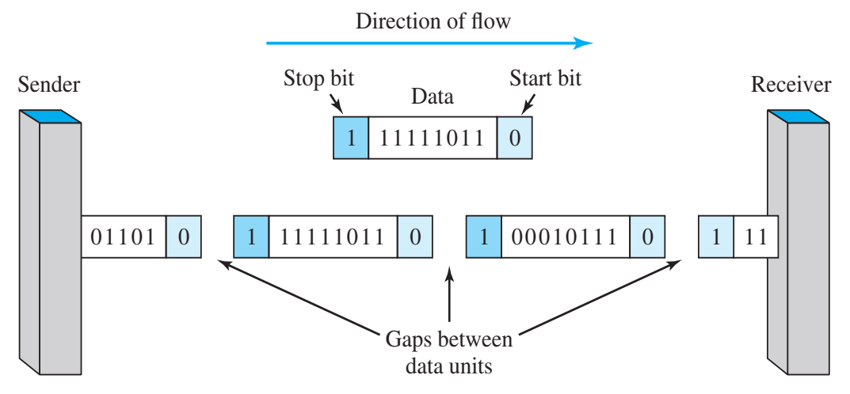
Asynchronous Serial Transmission
Asynchronous here means “asynchronous at the byte level,” but the bits are still synchronized; their durations are the same.
In asynchronous transmission, we send 1 start bit (0) at the beginning and 1 or more stop bits (1s) at the end of each byte. There may be a gap between each byte.

Slide 18
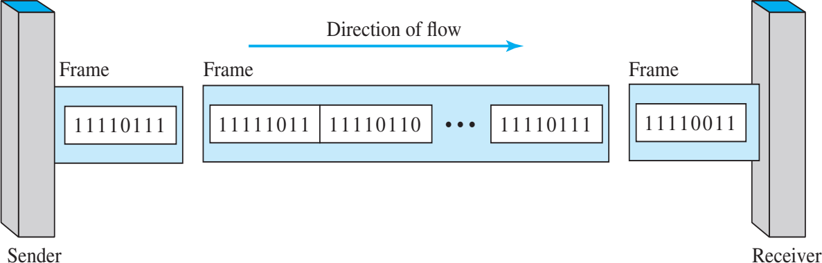
Synchronous Serial Transmission
In synchronous transmission, we send bits one after another without start or stop bits or gaps. It is the responsibility of the receiver to group the bits.

Slide 19
Isochronous Serial Transmission
In real-time audio and video, in which uneven delays between frames are not acceptable, synchronous transmission fails. For example, TV images are broadcast at the rate of 30 images per second; they must be viewed at the same rate. If each image is sent by using one or more frames, there should be no delays between frames. For this type of application, synchronization between characters is not enough; the entire stream of bits must be synchronized. The isochronous transmission guarantees that the data arrive at a fixed rate.

Slide 20

Data Communication Lecture Series, NRC, MAY2020
4.18

